Slide 1
Neural network and learning machines
Support Vector Machine – SVM

Slide 2
overview
SVM for linearly separable binary set
Main Goal to design a hyper plane that classify all training vectors into two classes
The best model that leaves the maximum margin from both classes
the two classes labels +1 (positive examples and -1 (negative examples)
X2
X1

Slide 3
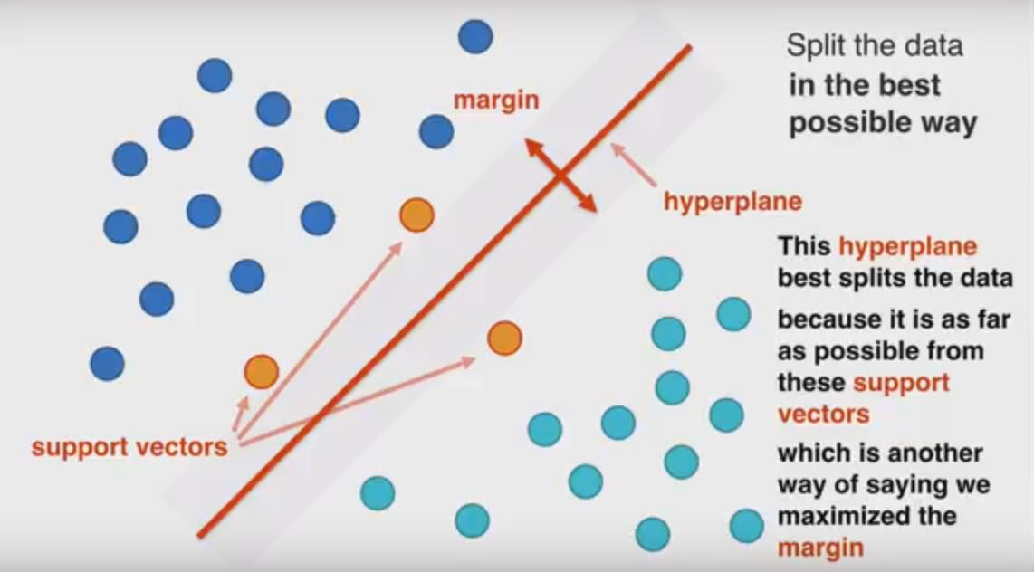
overview

Slide 4
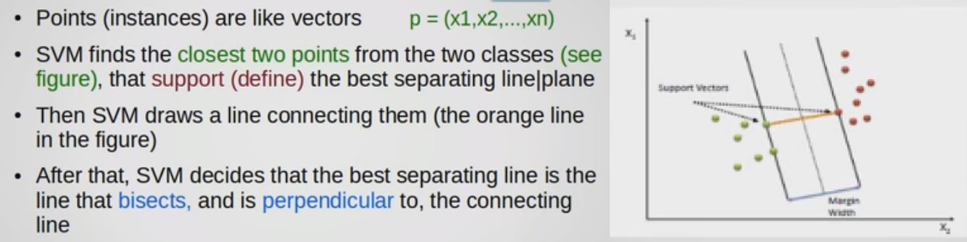
Intuition behind SVM

Slide 5
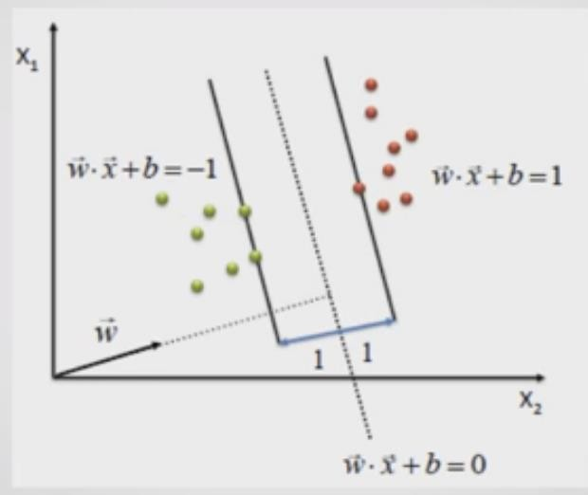

Slide 6
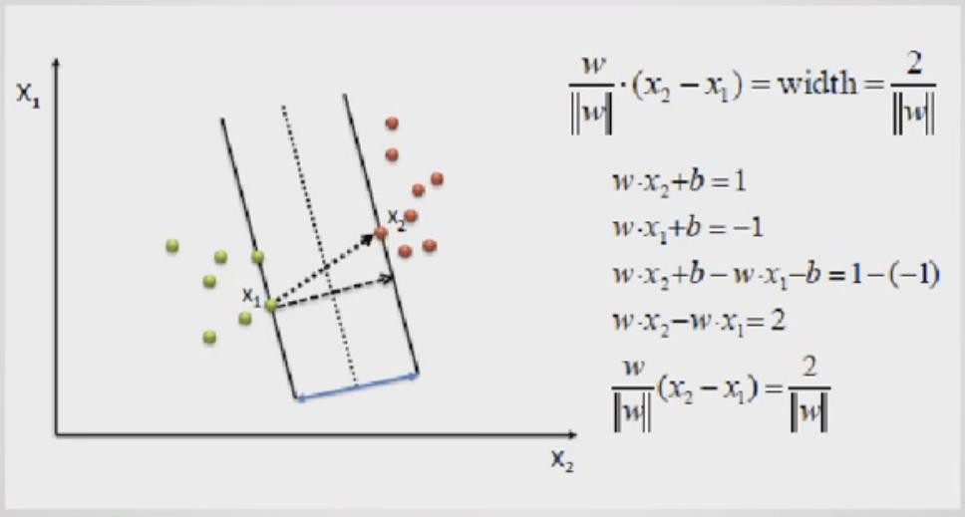
Margin in terms of W

Slide 7
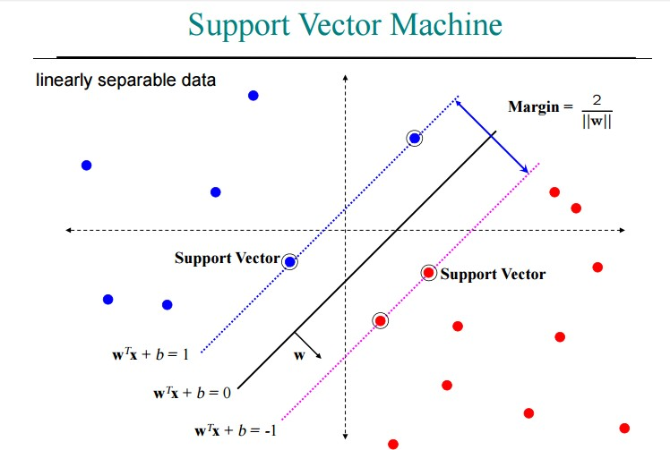

Slide 8
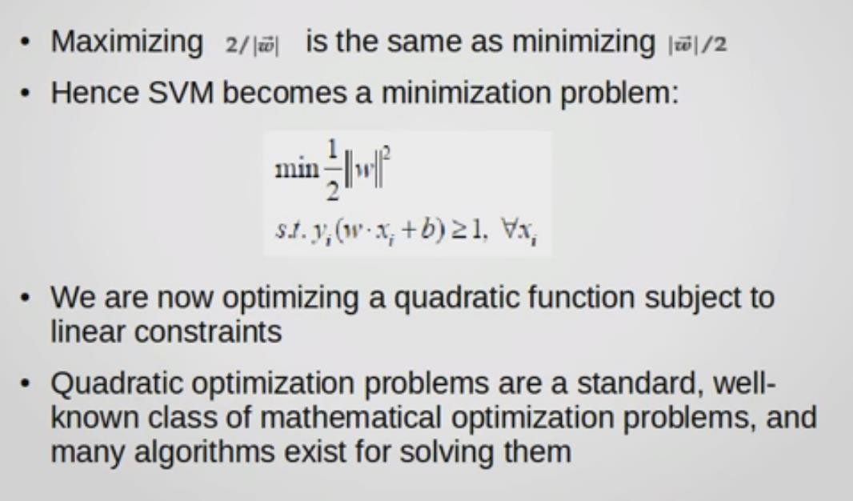
Svm as a minimization problem
Quadratic
problem
Linear constrain
9

Slide 9
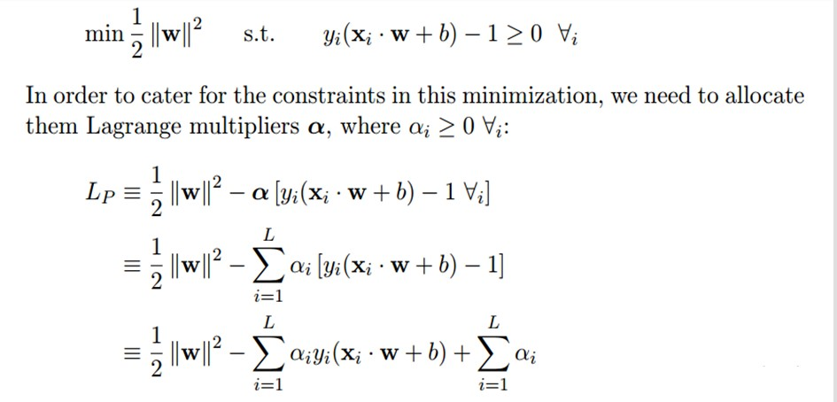
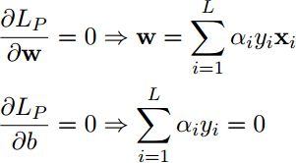
We wish to find the w and b which minimizes, and the α which maximizes LP(whilst keeping αi
≥ 0 ∀i). We can do this by differentiating LP with respect to w and b and setting the derivatives to zero:

Slide 10





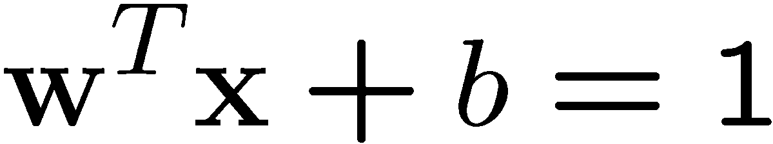
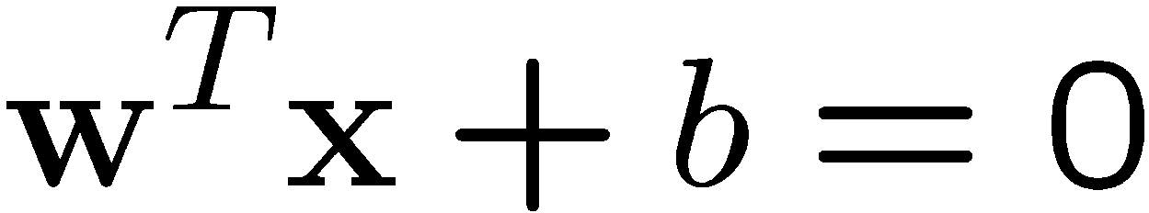
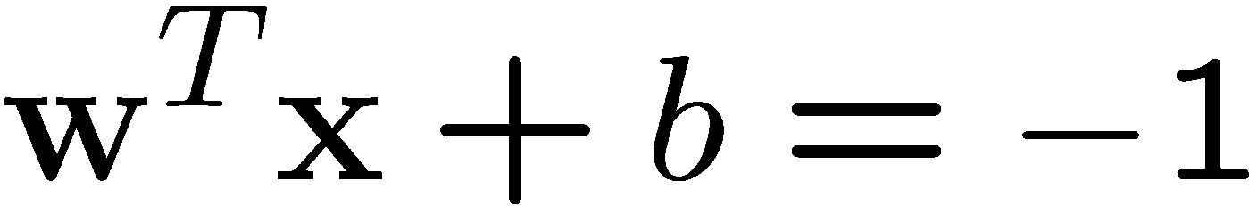
A Geometrical Interpretation
Class 2
α₁₀=0
α₈=0.6
α₇=0
α₂=0
α =0
5
α₁=0.8
α₄=0
α₆=1.4
α₉=0
Class 1
α₃=0

Slide 11
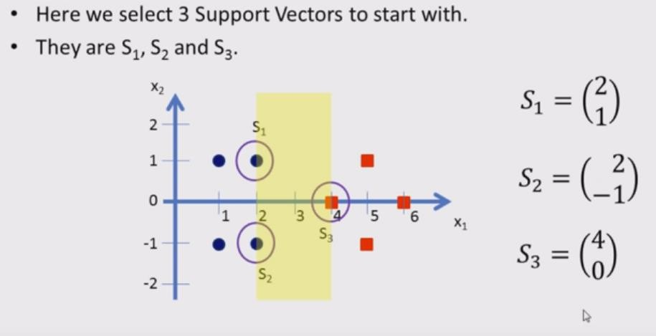
Example

Slide 12
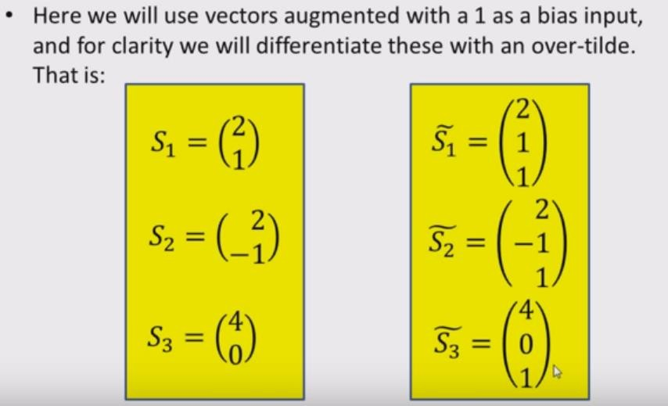
Example

Slide 13
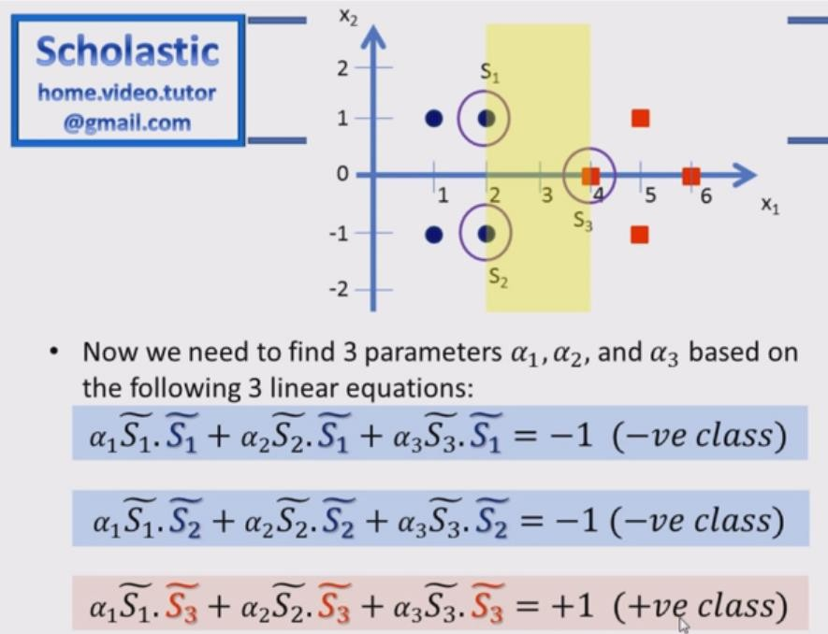

Example

Slide 14
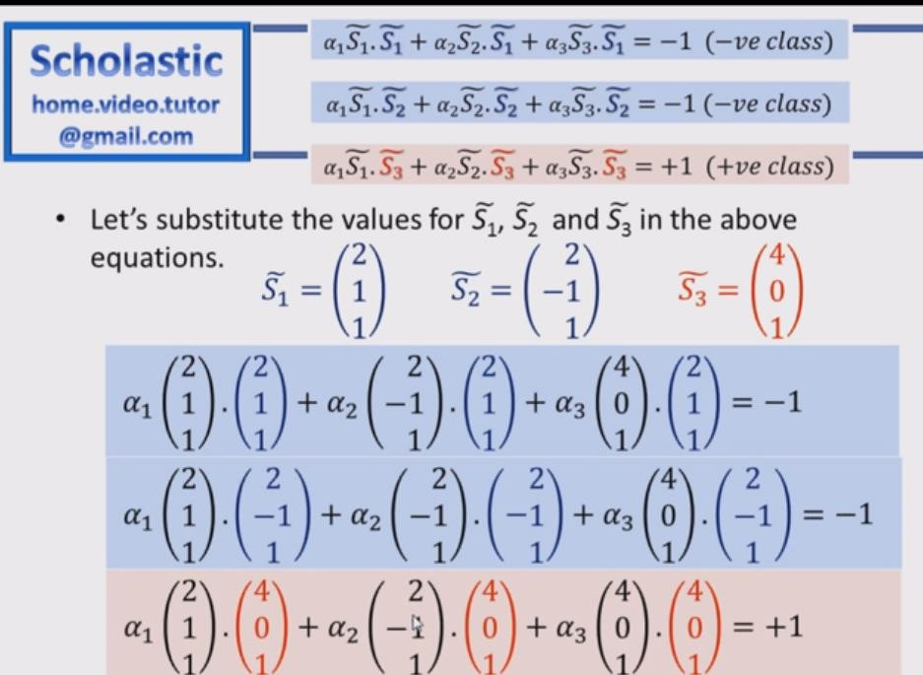
Example

Slide 15
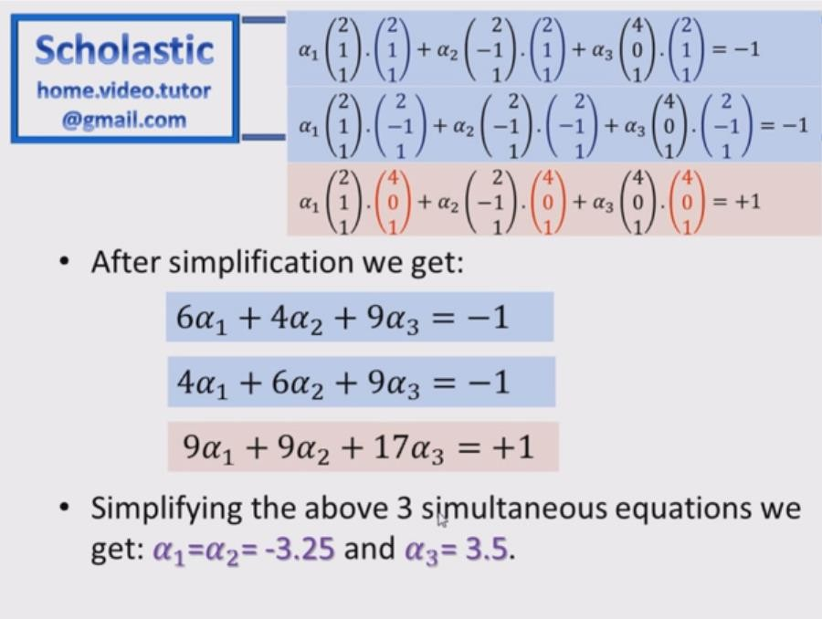
Example

Slide 16
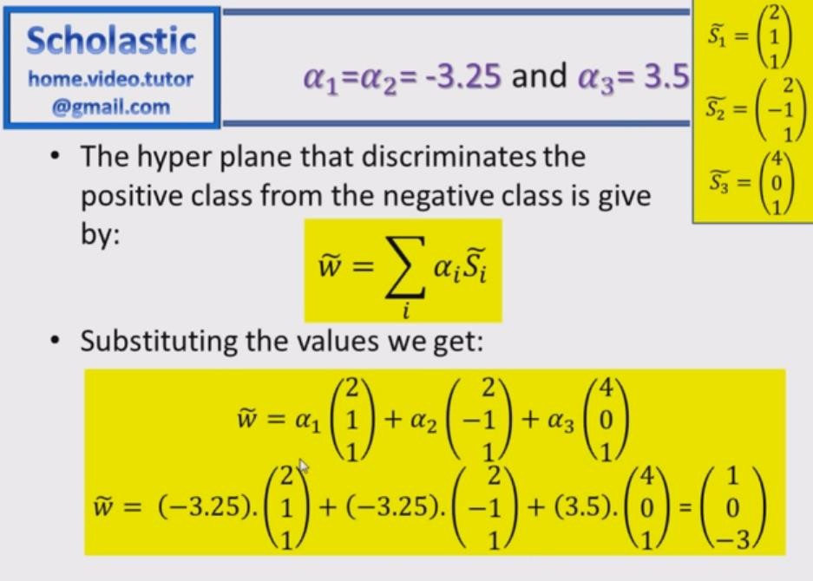

Slide 17
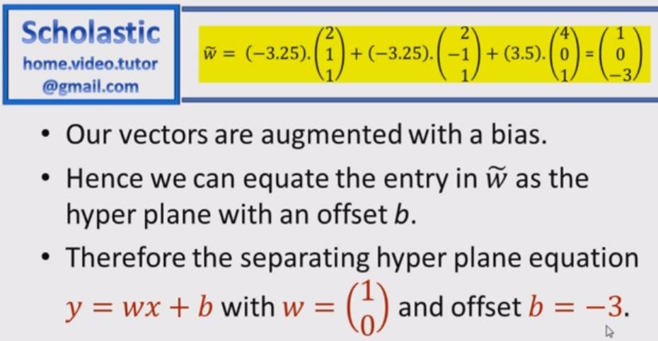

Slide 18
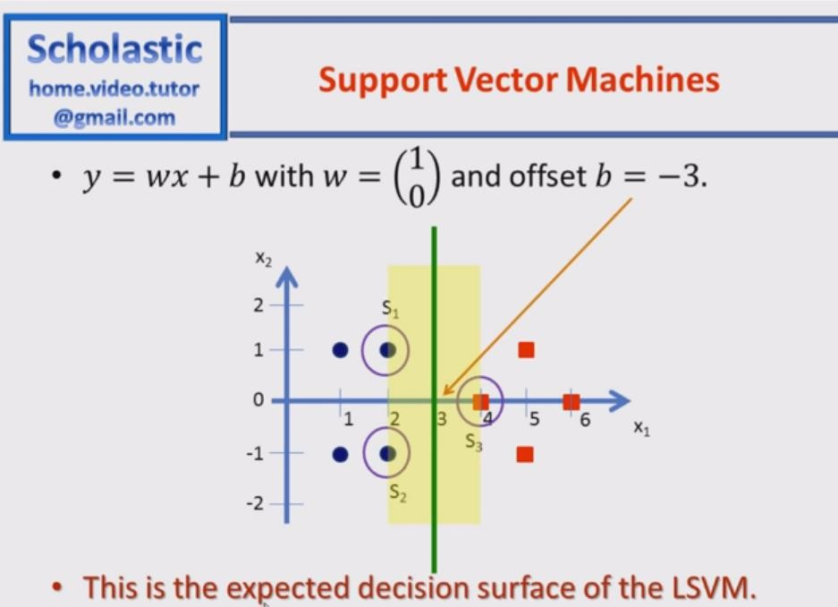

Slide 19
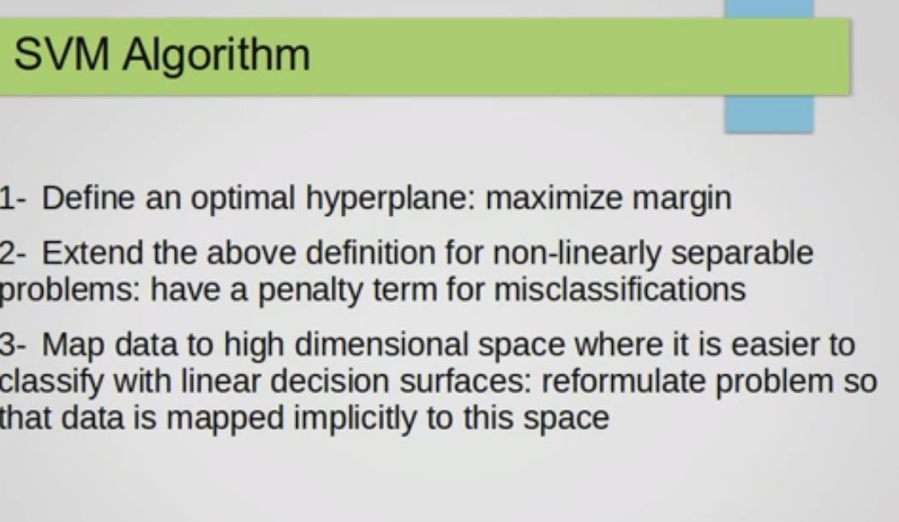
Kernel trick

Slide 20
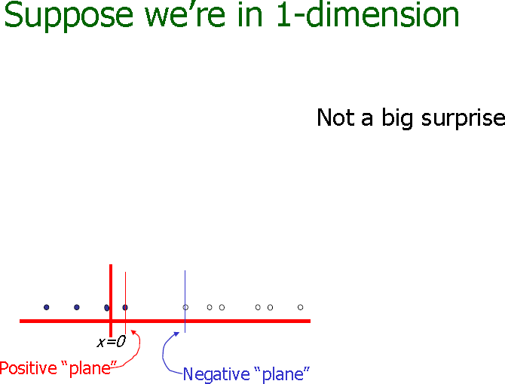

Slide 21
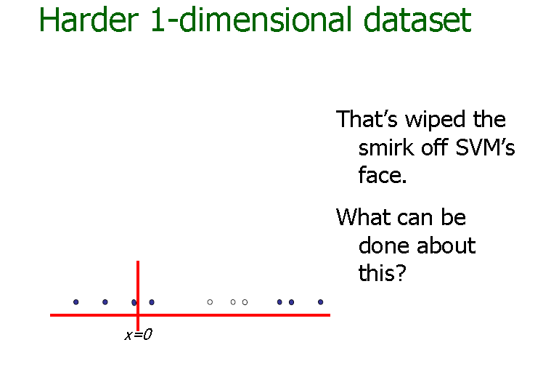

Slide 22
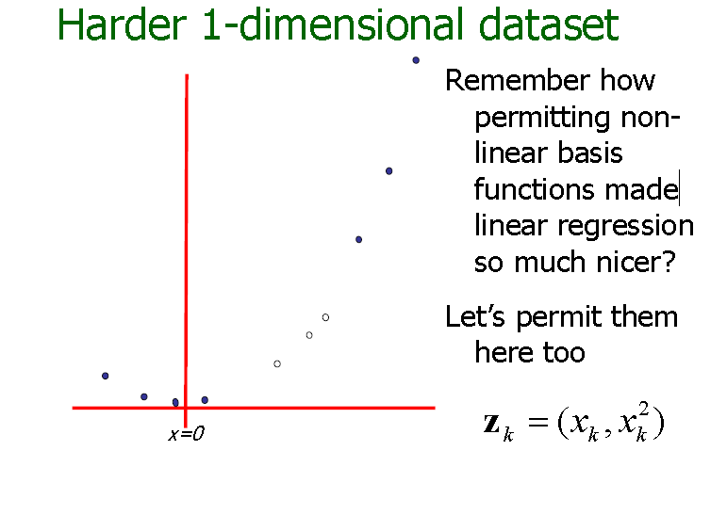

Slide 23
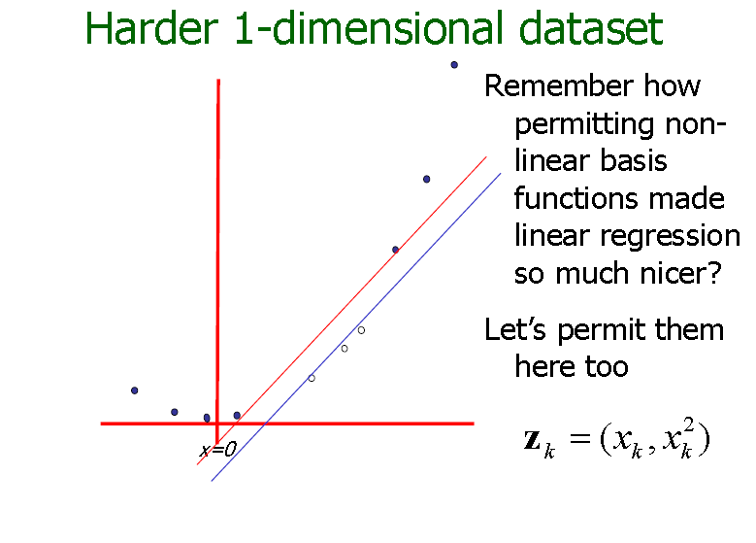

Slide 24
Non-linear SVMs: Feature spaces
General idea: the original feature space can always be mapped to some higher-dimensional feature space where the training set is separable:
Φ: x → φ(x)
27

Slide 25
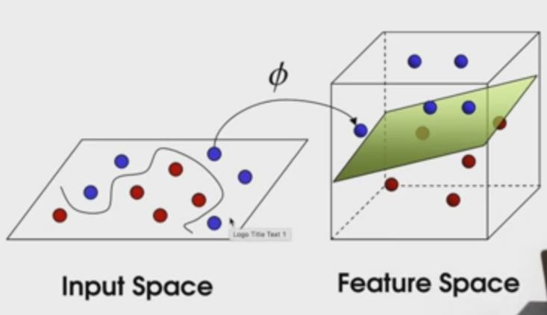

Slide 26
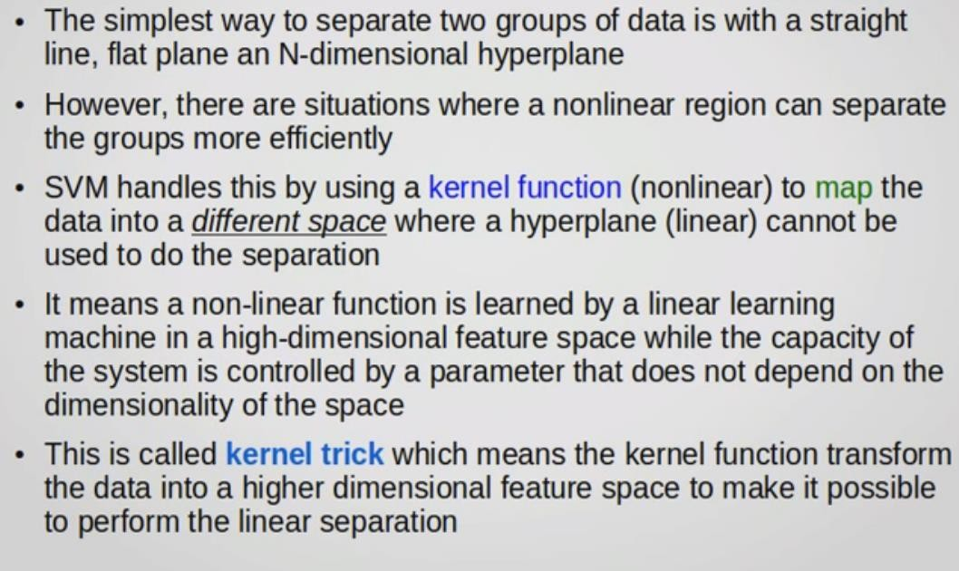
svm for nonlinear reparability

Slide 27

Kernels
Why use kernels?
Make non-separable problem separable.
Map data into better representational space
Common kernels
Linear
Polynomial K(x,z) = (1+x^{T}z)^{d}
Gives feature conjunctions
Radial basis function (infinite dimensional space)
Haven’t been very useful in text classification
30

Slide 28
Thanks

